Slide 1
MILESTONE - 3

Slide 2


Team 1
Food Brand Understand Customer Trends

Slide 3

OUR TEAM
01. Ganji Sindhu Priya
02. Parul Gautam
03. Varanasi Vinaykumar
04. Rohan Raj
Under the Guidance of
PAVITRA KANNAN

Slide 4

OVERVIEW
Introduction
Project Overview
-> Key Features
-> Milestones
Conclusion

Slide 5

INTRODUCTION
Project Overview:
This project evaluates customer preferences by combining sales, ratings, and sentiment to generate actionable product insights.
Core Functionalities
ICompare product categories by average ratings.
Analyse sentiment distribution (Positive, Neutral, Negative).
Perform sales vs rating correlation analysis.
Consolidate results in a Product Performance Matrix.
Outcomes
Delivers a holistic view of product strengths and weaknesses, enabling data-driven decisions for improvement, promotion, and strategy.

Slide 6

PROJECT OVERVIEW
Key Features:
This project highlights product-level performance through the following key features:
Category comparison using average customer ratings.
Sentiment analysis across categories to capture customer perceptions.
Correlation between sales volume and customer satisfaction.
Product-level summary including sales, ratings, and sentiment %.
Interactive exploration with slicers (Region, Age Group, Customer Segment, Item Type).

Slide 7




MILESTONES
01
02
03
04
05
Data Collection & Cleaning
Gathered dataset and ensured accuracy through preprocessing.
Feature Engineering
Created measures and customer segments (New, Regular, Loyal).
Sales & Product Dashboard
Built interactive dashboards for sales and product insights.
Customer Insights Dashboard
Analyzed customer demographics, segmentation, and loyalty.
Trends & Recommendations
Identified key trends and suggested strategic improvements.

Slide 8
SENTIMENTAL LOGIC – DAX MEASURES
Avg Rating = AVERAGE([Rating])
Positive Reviews = CALCULATE(COUNTROWS(Table), Table[Sentiment] = "Positive")
Negative Reviews = CALCULATE(COUNTROWS(Table), Table[Sentiment] = "Negative")
Neutral Reviews = CALCULATE(COUNTROWS(Table), Table[Sentiment] = "Neutral")
Positive % = DIVIDE([Positive Reviews], [Total Reviews], 0)
Negative % = DIVIDE([Negative Reviews], [Total Reviews], 0)

Slide 9

Product Insights Dashboard
Title: Product Insights & Performance Dashboard
Visuals Included: Average Rating by Category (Bar Chart): Evaluates satisfaction across product categories.
Sentiment Distribution (Stacked Bar): Breaks down positive, neutral, and negative feedback.
Sales vs Ratings (Scatter Plot): Shows correlation between sales and customer satisfaction.
Product Performance Matrix: Consolidates sales, ratings, and sentiment % into one view.
Dynamic Slicers: Region, Age Group, Item Type, and Customer Segment.

Slide 10
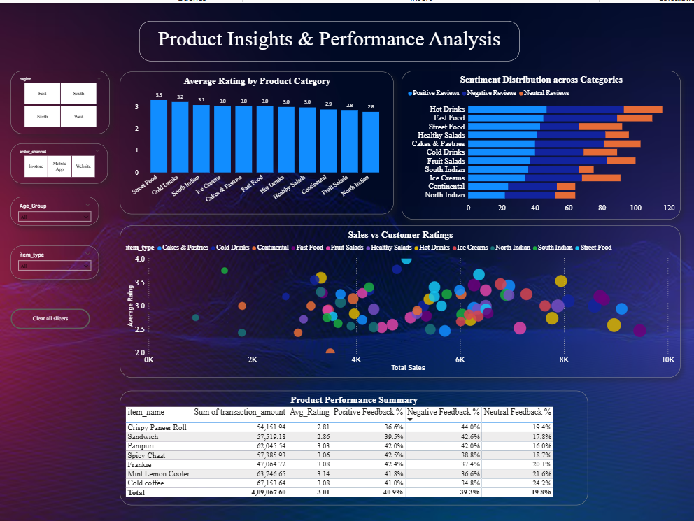
SENTIMENT INSIGHTS DASHBOARD

Slide 11
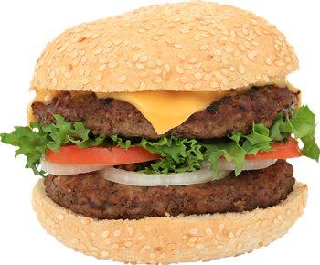
CONCLUSION
Milestone 3 provides a comprehensive view of product performance by integrating sales, ratings, and sentiment into a single dashboard.
The analysis highlights both strong performers and products needing improvement, while slicers ensure dynamic exploration across regions, age groups, and customer segments.
Looking ahead, the project can be enhanced with feature-level sentiment analysis for taste, price, and packaging, predictive modeling to forecast product success, and competitor benchmarking to refine market strategy.

Slide 12
Thank You

